Slide 1
Strategies to Help Preschoolers Develop Socioemotional Skills
Courtney N. Baker, Ph.D.
ReNEW Early Childhood Programs
Friday, August 23rd, 2016

Slide 2
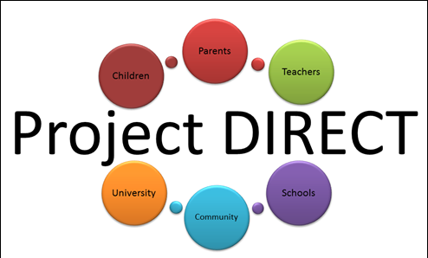

Slide 3
Roadmap
SEL and Early Childhood Development
Teaching SEL
  Direct instruction
  Provide a classroom environment that fosters SEL
Strategies to Teach SEL
  SEL curriculum
  Classroom behavior management
Project Pre-K TIPS Research Study

Slide 4
Socioemotional Learning (SEL)
Social and emotional learning (SEL) is the process through which children and adults acquire and effectively apply the knowledge, attitudes, and skills necessary to understand and manage emotions, set and achieve positive goals, feel and show empathy for others, establish and maintain positive relationships, and make responsible decisions.
CASEL, 2015

Slide 5
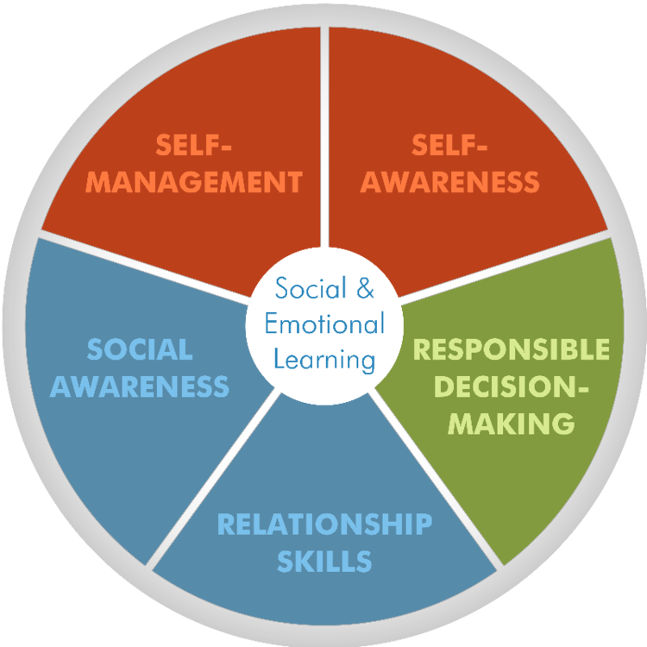
Socioemotional Learning (SEL)
CASEL, 2015

Slide 6
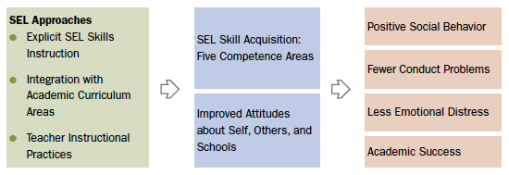
Socioemotional Learning (SEL)
CASEL, 2015

Slide 7
Research on SEL
Better academic performance: achievement scores an average of 11 percentile points higher than students who did not receive SEL instruction;
Improved attitudes and behaviors: greater motivation to learn, deeper commitment to school, increased time devoted to schoolwork, and better classroom behavior;
Fewer negative behaviors: decreased disruptive class behavior, noncompliance, aggression, delinquent acts, and disciplinary referrals; and
Reduced emotional distress: fewer reports of student depression, anxiety, stress, and social withdrawal.
CASEL, 2015; Durlak et al., 2011
Notes:
Research shows that SEL can have a positive impact on school climate and promote a host of academic, social, and emotional benefits for students. Durlak, Weissberg et al.'s recent meta-analysis of 213 rigorous studies of SEL in schools indicates that students receiving quality SEL instruction demonstrated:

Slide 8

SEL and Early Childhood Development

Slide 9
Teaching SEL
Teaching social and emotional skills directly
  Curriculum and instruction
Provide a classroom environment that fosters SEL
  Safe and predictable
  Emotionally supportive and responsive
  Use of positive discipline practices
Notes:
Some SEL programs teach social and emotional skills directly. Occasionally programs address topics such as substance abuse prevention, violence prevention, health promotion and character education. Other SEL approaches have specific curricular and instructional components that foster safe, caring, engaging and participatory learning environments that build attachment to school, motivation to learn, and academic achievement.
Recent research has established that the quality of student-teacher interactions and the instructional practices that take place within the classroom are two important predictors of student academic performance and social adjustment. Teacher-focused SEL programs train teachers to be more emotionally supportive of their students or to use positive discipline practices to respond to students' needs. These strategies also enhance student skill development.

Slide 10
Insufficient
Implementation (Dose)
Barriers to Accessing
Services
Low Quality Implementation
Inadequate Consideration of
Context

Slide 11
Sufficient
Implementation (Dose)
Easy-to-Access Services
High Quality Implementation
Thoughtful Consideration of
Context

Slide 12
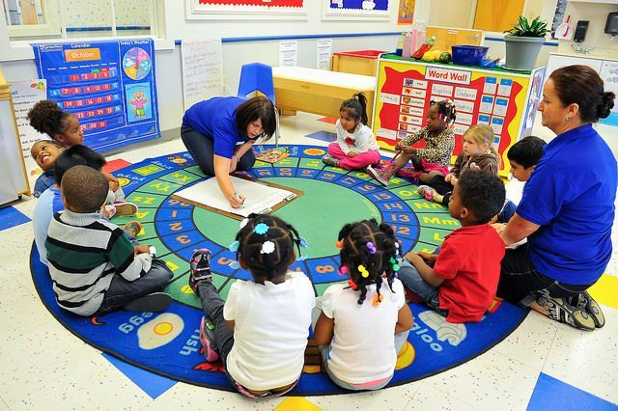
Direct Instruction in SEL

Slide 13
Direct Instruction in SEL
How?
  Teach
    Curriculum guide
    Lesson materials
  Generalize
    Tips to integrate into daily classroom activities
    Help spotting natural times to support children’s practice of SEL skills
    Parent handout and “homework”
  Maintain
    Building an SEL classroom, one lesson at a time

Slide 14
SEL Curriculum Topics
Feelings identification and vocabulary
Managing strong feelings
  Deep breathing
  Take a break
  Coping self-talk
  Tucker the Turtle technique
Identifying feelings in others and empathy
Being a good friend
Problem solving

Slide 15
Fostering SEL in the Classroom
Create a safe and predicable environment
  Clear class rules
  Clear commands
  Routines for attention and transitions
Create an emotionally supportive and responsive classroom
  4:1 positive:negative interactions; 1 positive interaction per child every 5 minutes
  Behavior-specific praise
Use of positive discipline practices
  Planned ignoring
  Concise, informative reprimand

Slide 16
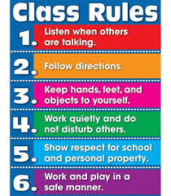
Class Rules
Age-appropriate
Specific and observable
Stated positively
Easy to understand
Enforceable
3-5 rules total
Reinke et al., 2012

Slide 17
Commands
Get the child’s attention
Clear and simple
Enforceable
One at a time

Slide 18
Routines
Routine for getting students’ attention and transitions
  Explicitly teach routine
  Preteach (transition only)
  Reward successes
  Examples
    Hand up for quiet attention
    5 and 1 minute warning for clean up and transition

Slide 19
Positive Interactions
4:1 positive to negative interactions
  Notice rule-following behaviors
At least 1 positive interaction per student every 5 minutes
Examples
  Praise, warm tone, high five, smile, personal comment about child, engaging instruction, eye contact
  Noticing the times when everyone, even children with lots of disruptive behavior, are following the rules

Slide 20
Behavior-Specific Praise
Why?
  Positive reinforcement
Specific praise or praise that includes a description of the behavior being praised
Examples
  “Good job finishing your math worksheet.”
  “Thank you for raising your hand.”
  “Everyone has their eyes on me. Good.”
Reinke et al., 2012

Slide 21
Planned Ignoring
Why?
  Positive reinforcement
Ignore minor misbehavior
And then attend to and reward rule-following behaviors
Examples
  During clean up time, ignore child tapping blocks on floor instead of cleaning
  Attend the second the child begins to clean up and praise “Great job cleaning up those blocks!”

Slide 22
Concise, Informative Reprimand
Verbal comments or gestures by teacher to indicate disapproval of behavior
  Brief
  Normal speaking tone
  Direct attention to the rule that was violated
  Indicate what the behavior should be
  And then attend to and reward rule-following behavior
Examples
  “China, please have a seat” (when China gets out of her seat)
  “I am talking, eyes on me” (when a group of children are talking)
  Finger to lips when students are talking
Reinke et al., 2012

Slide 23
Video Example
http://www.youtube.com/watch?v=-g0HuLG6M_Y

Slide 24

Project Pre-K TIPS
Goal: To evaluate whether Project DIRECT’s coaching model…
  Is feasible and acceptable to teachers
  Helps children develop socioemotional skills
Funded by the Louisiana Board of Regents

Slide 25
Project Pre-K TIPS
Activities
  PD Training on SEL
  Weekly coaching throughout the school year (~21 weeks)
  Support for challenging behaviors in the classroom
Notes:
A one-off PD isn’t enough…

Slide 26
Project Pre-K TIPS
Research Study
  Comparing two types of coaching
  Random assignment
Evaluation Plan
Notes:
Discuss classroom observations – two types of observations

Slide 27
Project Pre-K TIPS
Being part of a research study
  Privacy and confidentiality, your information will not be shared with anyone at your job
  Voluntary, whether you decide to participate or not will not affect your job
  Opportunity to contribute to knowledge about SEL

Slide 28
Project Pre-K TIPS
Timeline
  PD Training (Today)
  Recruitment and Consenting (~8/29-9/16)
    Teachers
    Students (Parents) – Classroom incentive
  Pretest Data Collection (~9/19-10/21)
  Coaching (~10/24-4/14)
  Posttest Data Collection (~4/17-5/12)

Slide 29

Thank you!

